Slide 1

Moscow house building plant. dsk
the presentation was prepared by
Saltashkina Anastasia
Yanchenko Anastasia
Nikitaeva Victoria

Slide 2
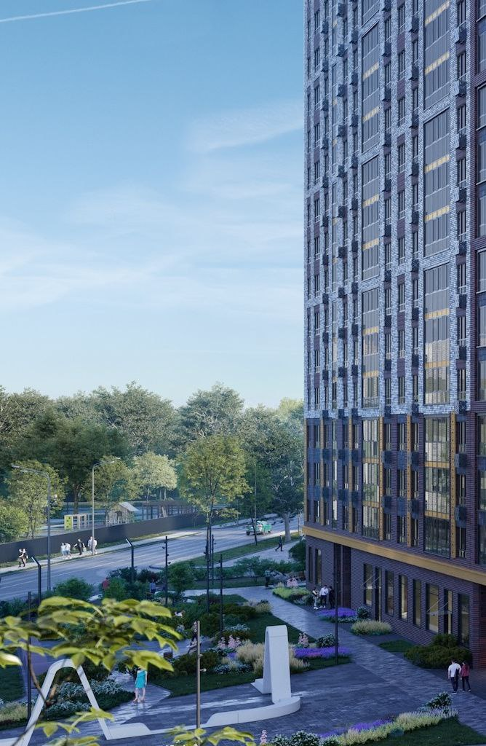
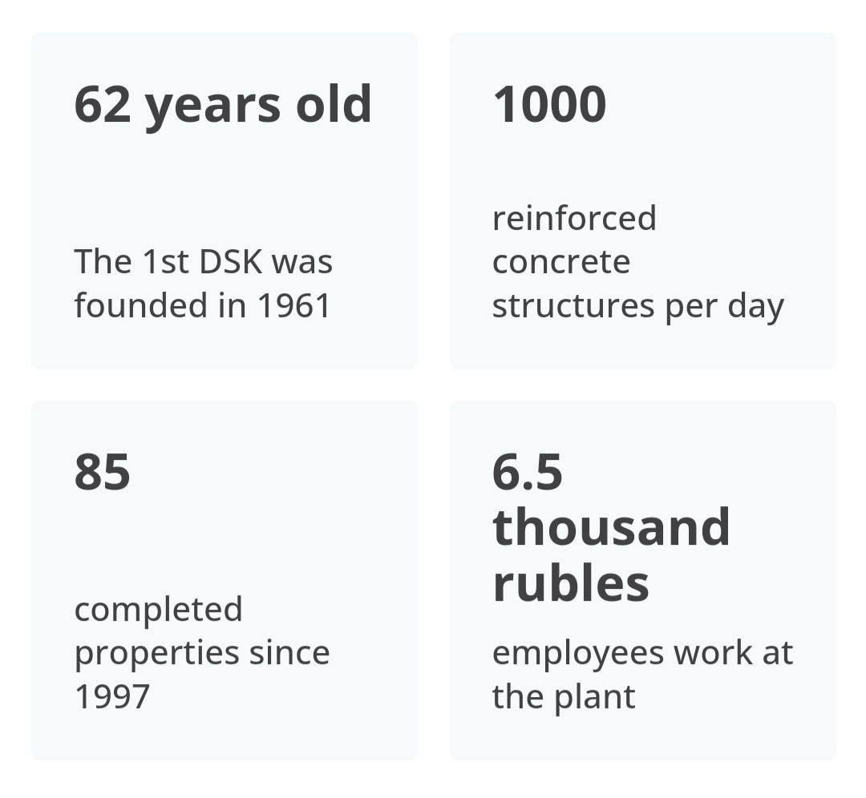
Some statistics of this company, which is presented on the official website

Slide 3
What the company does

Slide 4
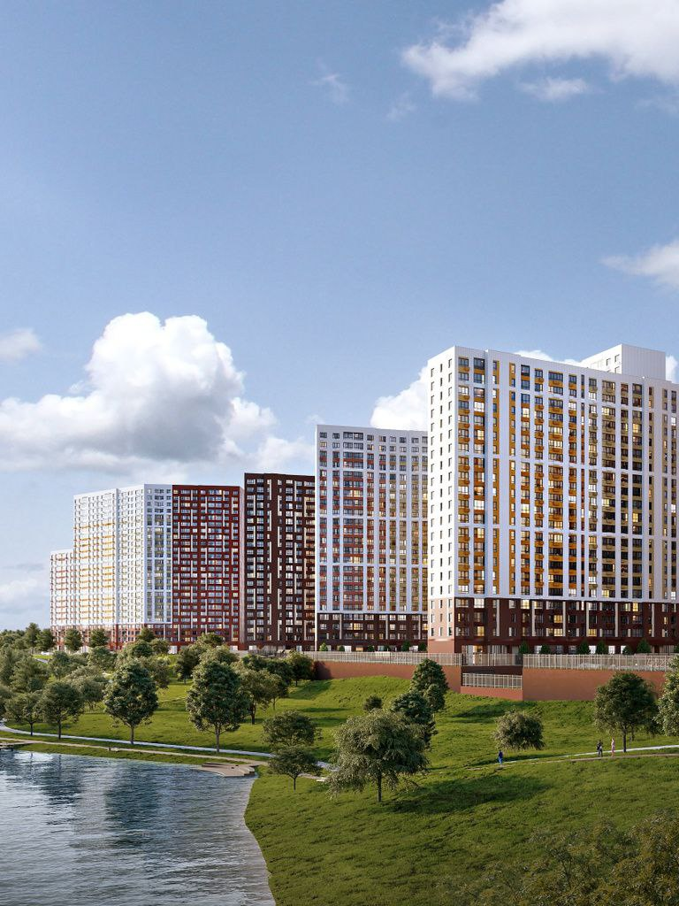
1. specialises in the production of concrete and building construction 2. provides execution of construction projects 3. company develops architectural and engineering projects

Slide 5
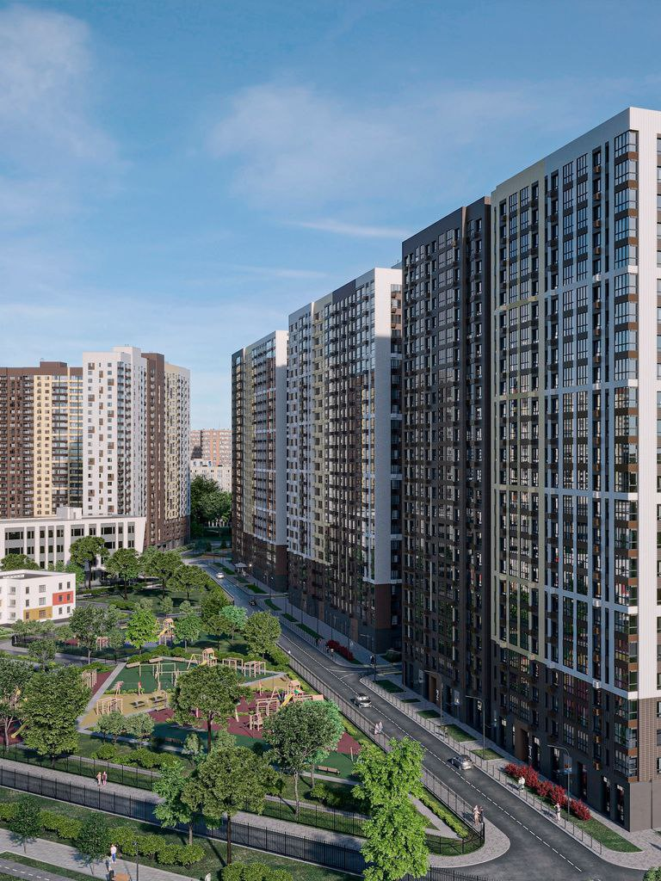
1. The DSK has a high level of organization 2. DSK recognises all stages of construction including project management 3. This company can invest in new projects

Slide 6
Where is the company located

Slide 7
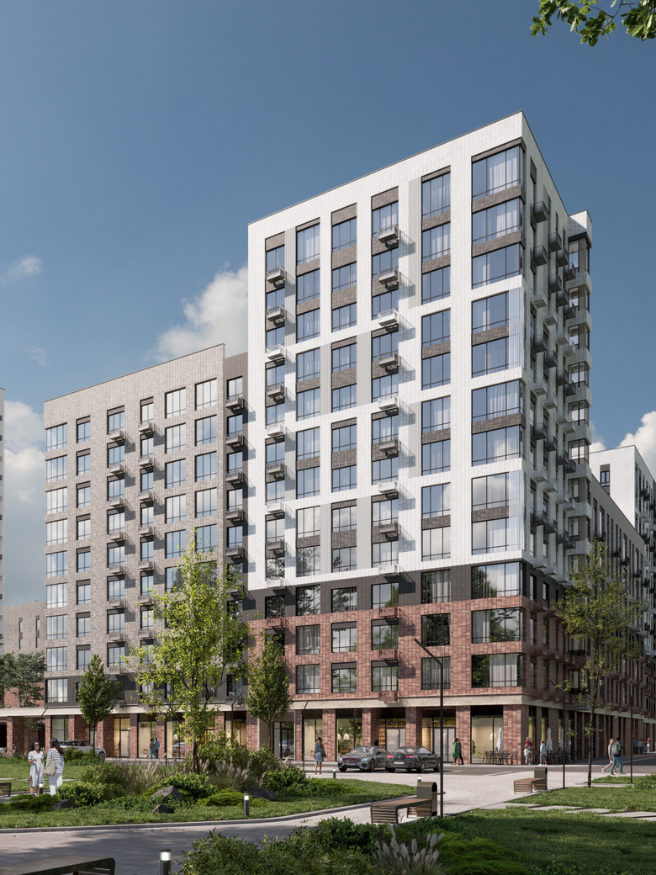
1. the company's head office is located in Moscow 2. company has branches in different cities

Slide 8
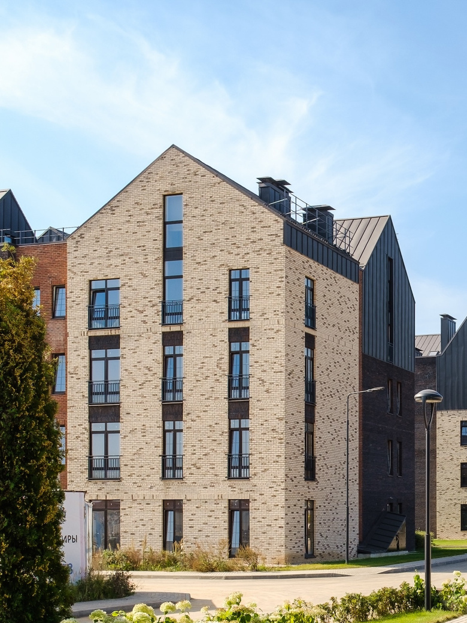
The main responsibilities of the company's divisions are 1. design and construction of residential complexes 2. production of building materials 3. construction of high-rise buildings and cottages

Slide 9

The main responsibilities of the company's divisions are 4. construction of shopping malls, industrial facilities 5. reconstruction of historical buildings 6. production of building materials

Slide 10
how the company structured

Slide 11

1. Board of Directors 2. CEO 3. Executive Management 4. Middle managers 5. Workers and specialists

